Slide 1
LINE UP

Slide 2

“Review“ of Mini Project
For E-3 2018 Admitted Batch
Submitted as a part of Mini Project
Presented by
G.Lakshmi Neeraja
(S180746)
P.H.K Mahalakshmi
(S180404)
G.Srinu
(S180989)
Under the guidance of
M.Roopa
Assistant Professor
Department of CSE

Slide 3
Table of Contents:
Abstract
Introduction
Existing System
Proposing System
Technical Stack
Hardware and Software Requirements
Conclusion

Slide 4
ABSTRACT
A Line Up is a list of tasks that need to be completed, typically organized in order of priority. It is one of the simplest solutions for task management and provides a minimal and elegant way for managing tasks a person wishes to accomplish . Our aim is to design a simple and elegant website for people to keep a track of the status of their tasks. Making a Lineup is an easy and important task that everyone should do .The immense satisfaction that one gets when completing the task and marking it on the list are incomparable .Moreover, creating a list of tasks ensure you don’t miss out on anything. It’s a scientific fact that when you write the task that you need to complete, you are even more motivated to complete it. With this in mind, we come to build a platform which will help people create their own task list . With the help of modern tools and technologies, we strive to build a minimal and efficient Line Up which minimizes distractions and helps people achieve task management with ease and without hassle.

Slide 5
Introduction
In today’s fast-paced and busy world, individuals face numerous challenges in managing their time, staying organized, and achieving a healthy work-life balance. The demands of work, personal commitments, and constant connectivity can often lead to stress, burnout, and a sense of being constantly behind schedule. The pace of modern life often requires individuals to find ways to optimize their productivity and make the most of their limited time.
As a result ,there is a clear need for solution that can help individuals effectively manage their time, tasks, and overall well-being.
The objective of this project is to create a simple prioritized list of the tasks a person must complete. People make a list of everything they need to do, ranked according to priority from the most critical task at the top to the least critical task at the bottom.
A few of the features of a good Line Up application include:
Plan and execute simple actions.
Prioritize, manage, and reason about tasks.
Record notes, action items and ideas.

Slide 6
Statement of the problem
The use of traditional to-do lists and existing to-do list applications present several limitations and challenges that hinder effective task management, productivity and user experience . These limitations create the need for a new and improved to-do list application . Many existing applications do not provide a centralized and unified platform for users to manage all their tasks in one place . Existing applications lack robust prioritization feature, making it difficult for users to differentiate level of the task . Therefore, the problem at hand is to develop an a simple prioritized list of the tasks a person must complete. People make a list of everything they need to do, ranked according to priority from the most critical task at the top to the least critical task at the bottom.

Slide 7
Goals
To provide users with a centralized platform to organize and manage their tasks effectively.
The application should allow users to capture, categorize, and prioritize tasks in a structured and easily accessible manner.
To allow users to add comprehensive details to their tasks, such as descriptions, due dates, attachments, subtasks, and labels.
Customization options should be provided to tailor the task management system to individual preferences and workflows.
To prioritize data security and privacy to protect users' sensitive information and task data.
Appropriate measures should be implemented to ensure secure storage and transmission of data.

Slide 8
Existing System
Existing systems for to-do list management vary widely in terms of functionality, platforms, and features. Todoist is a widely used task management application available on web browsers, mobile devices and desktop platforms. It offers features such as task creation, due dates, priorities, labels, and project organization. It provides collaboration options for team-based task management. It lacks some of the advanced features available in Line Up
Drawbacks of existing system :
Limited Free version
Complex user interface
Dependency on internet connectivity

Slide 9
Proposing System
Line Up application is to provide users with a user-friendly interface where they can create , organize, and monitor their tasks in a centralized location. The application will enable users to easily capture and record their tasks, set deadlines and remainders, assign priorities, and track their progress. By having all their tasks in one place, users can avoid forgetting important responsibilities and ensure that everything is completed on time.
The Line Up project will offer several key features to enhance task management and productivity. Users will be able to create new tasks by providing essential details such as task titles, descriptions, due dates and priority levels. They can categorize tasks into different projects or categories for better organization.

Slide 10
Features of Proposing System
The application will provide options to edit, delete, mark tasks as complete or incomplete, and search for specific tasks based on various criteria.
It can do Task Prioritization and Sorting. It assigns priority levels of task(i.e : high, medium, low) indicate their importance or urgency.
Line Up can sort tasks based on priority ,due date, or custom criteria.
It can include a status field for each task, representing its current state or progress.
Allow users to update the status of tasks as they progress. Users can manually change the status of a task based on its current state.
Free version of application.
Independent of internet connectivity
Simple and friendly interface

Slide 11
Modules of the Line Up Interface:
User Dashboard
Task Management
Searching on different criteria
Sorting with option

Slide 12
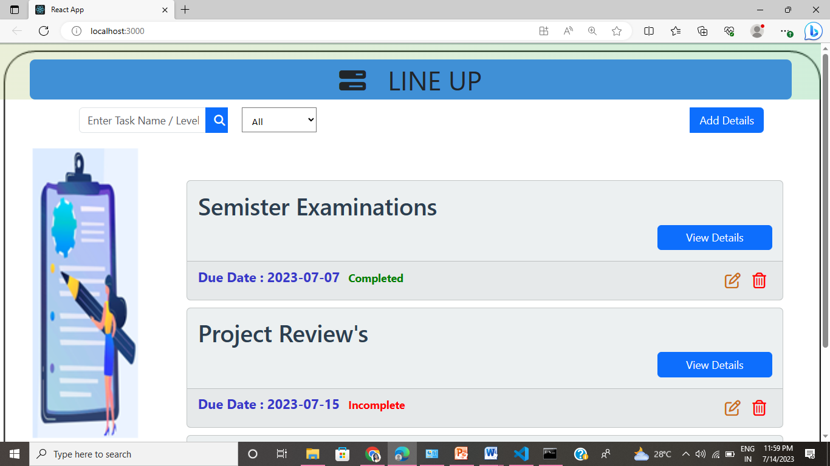
Dashboard of the LineUp:

Slide 13
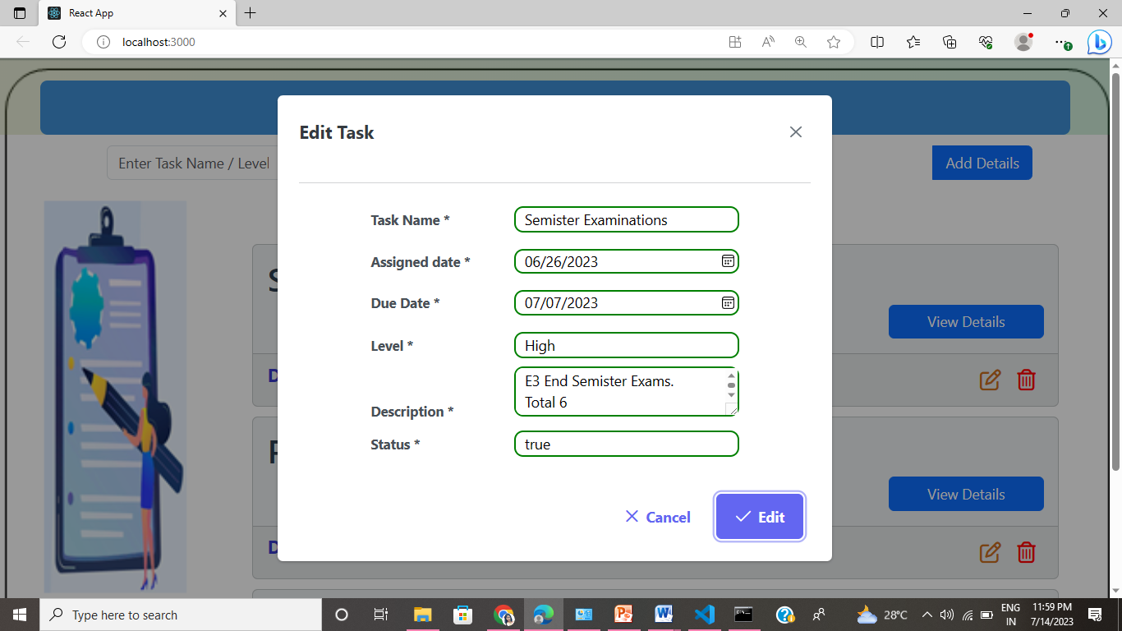
Task Management:
User Dashboard
Task Management
Searching on different criteria
Sorting tasks on some criteria

Slide 14
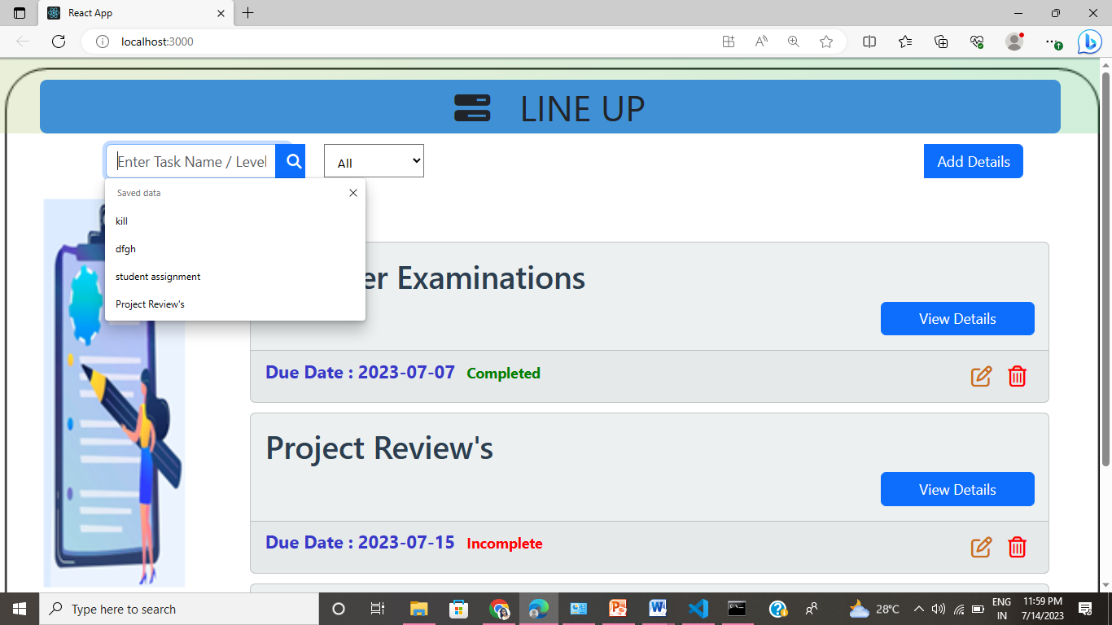
Search on different Criteria:
User Dashboard
Task Management
Searching on different criteria
Sorting tasks on some criteria

Slide 15
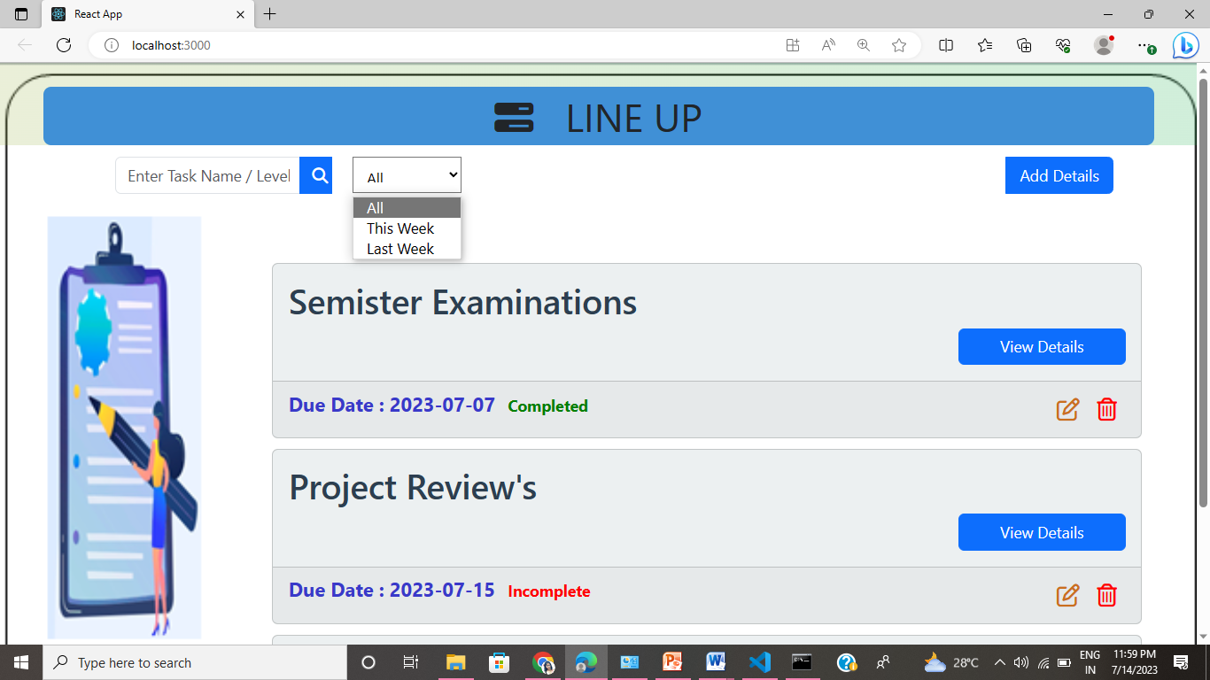
Sorting with option:
User Dashboard
Task Management
Searching on different criteria
Sorting tasks on some criteria

Slide 16
Technology Stack
Front-End
HTML
CSS
Javascript
React.js
Back-end
Django
Databases
Mysql

Slide 17
Hardware Requirements
Laptop or PC with:
I3 processor system or higher
4 GB RAM or higher
100 GB ROM or higher
Operating System : Windows 7 or higher
Web Technologies : HTML, CSS, Javascript, Django, React.js
IDE : Visual Studio
Database : MySQL
Software Requirements

Slide 18
Conclusion
Line Up Project is used to provide a practical and efficiency solution for managing task and organizing daily activities by implementing a lineup application uses can benefit from various features such as task creation due date management collaboration and more the project focus on simplifying task Management increasing productivity and ensuring that important as are completed on time.
Throughout the development process it is crucial to consider user requirements and feedback to create a user friendly interface that need that needs additionally integrating the application with other tools and platform such as calendars of third party applications can enhance its functionality and usability
The success of a lineup project lies in its ability to provide it streamlined and intuitive user experience allowing uses to easily create organized and track their task regular updates and improvements based on user feedback can further enhance the application and keep it aligned with evolving user requirements.
Ultimately the goal of a lineup project is to empower uses to efficiently manage their tasks, increase productivity and reduce stress by providing a reliable and accessible tool for task organization and management

